Slide 1
FYP Report 1: Presentation
Group Members:
Name: Muhammad Talha.
Roll No: FA20-BCS-007
Name: Hassan Mahmood.
Roll No: SP20-BCS-114
Supervisor:
Dr. Wajahat Mehmood Qazi

Slide 2
Deepfakes Text to Speech (TTS)
DeepCloning.AI

Slide 3
What are DeepFakes ?
As, AI advances, it revolutionize the video, photo and Audio Manipulation.
Realistic Fake Content known as DeepFakes
Deepfakes is a combination of words Deep which is Deep learning and Fake.
While the act of creating fake content is not new, Deepfakes leverage powerful techniques from machine learning and artificial intelligence to manipulate or generate visual and audio content that can more easily deceive.
Example given Below which shows a Deepfake content:

Slide 4

Deep Fake Example

Slide 5
Limitations of Deepfakes
Data Requirements: Lots of Data needed to Develop a Deepfake Content for estimation need data in GBs.
Computation Resources: As, uses Deep Learning Architectures and GANs for creation, so need lots of Computing resources, GPU needed for Training on Dataset.
Technical Expertise: While there exist user-friendly tools for creating basic deepfakes, more advanced and convincing Deepfakes content often requires technical expertise. This limits the accessibility for every individual.
Basic Deepfakes can be created easily using different software which are available now such as Mid Journey, DALL.E, etc. An example is given below

Slide 6
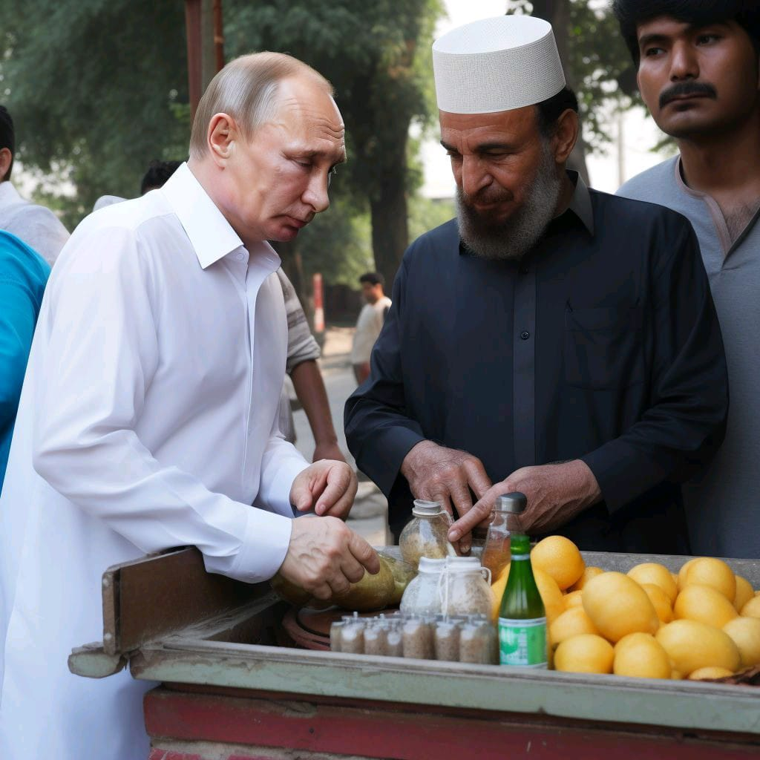
Example of Deep Fakes

Slide 7
Social Impacts of Deepfakes
Ethical Concerns: Deepfakes can be used for malicious purposes, such as creating fake news, spreading disinformation. This raises ethical concerns in Society.
Unauthorized Use: Creating deepfakes without permission can violate individual's privacy and lead to legal consequences. Currently, the lack of regulations for addressing deepfake-related issues can be problematic.
Trust Erosion: The deepfakes content can contribute to a erosion of trust, as people may accept the media content authentic.
Right now, there are many Deepfakes exist on internet, mostly of famous personalities. Majority of them are created for misuse and to promote misguidance.

Slide 8
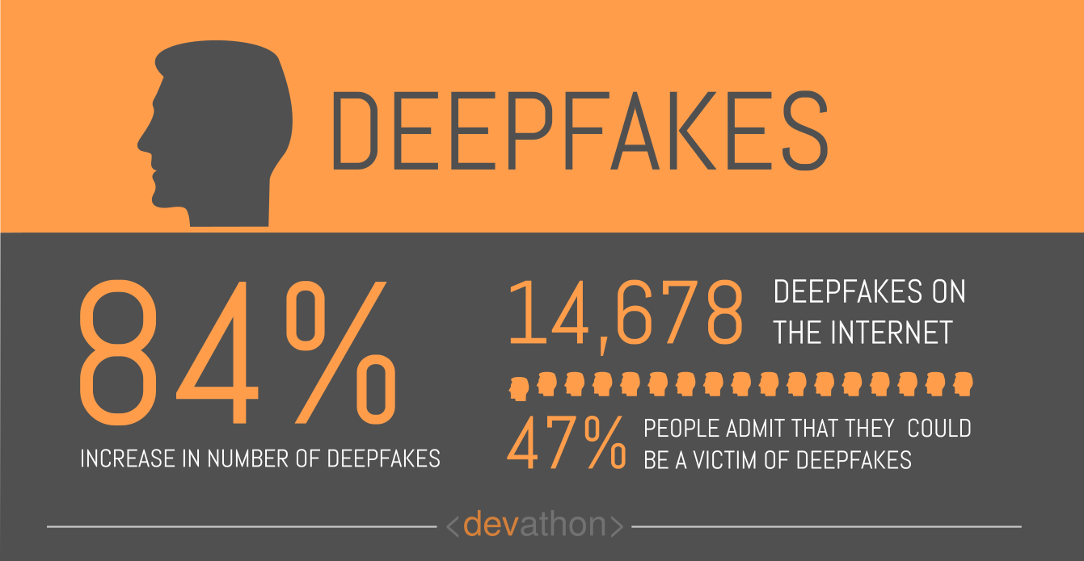
Statistics related to DeepFakes

Slide 9
Deep Fake
As, AI advances, it revolutionize the video, photo and Audio Manipulation.
Realistic Fake Content known as Deep Fakes
Definition:
Deep Fake are videos or images that replace some one likeness with someone else.

Slide 10
Deep Learning
Machine Learning Technique
Learns on unstructured & Complex data
Deep Fake created by training Deep Learning Model.
Large Dataset of Video or Audio required for Fake creation.

Slide 11
Deep Fake
DEEP FAKE :
Deep Learning + Fake

Slide 12
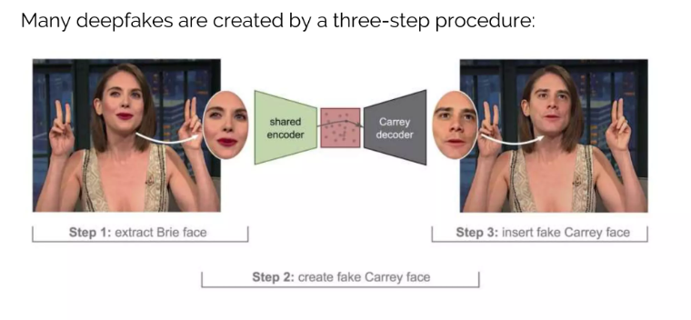
Deep Fake Creation

Slide 13
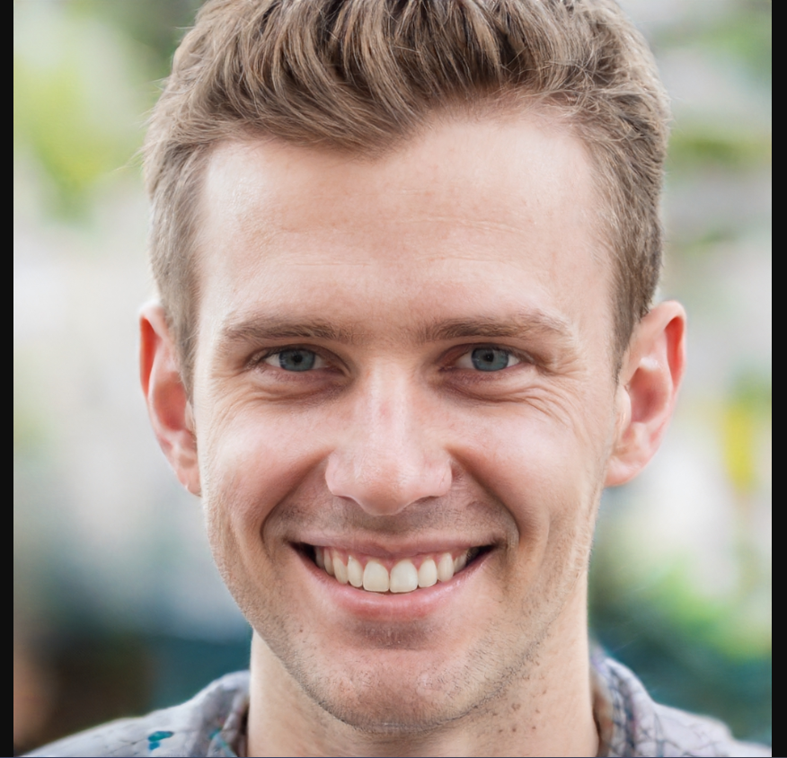
Is this Person Exist ???

Slide 14
Deep Fake
Visuals influence Humans a lot.

Slide 15
Use Cases
Low cost Advertisements
Art work and films
Education
Media Industry

Slide 16
Misuse of Deep fake
Non-existent person
Politics / Scamming
Blackmail

Slide 17
Statistics

Slide 18
Impact & Preventions
False info related to you
Share less Content
Deep fake creation still need lots of data, but advancement in technology make it easier.

Slide 19
Deep Fake
Interested Examples

Slide 20
Deep Fake
Thank You!

